Slide 1
CONDITIONAL LOGIC IN EXCEL: IF FUNCTIONS AND MORE
HSBC Tech Apprentice Programme
2023

Slide 2

agenda
Topic one
IF function
AND / OR function
IFERROR function
Other logical functions
Exercises
Image generated by Dall-E

Slide 3
If function
The logical test can be almost anything
Comparing cell value to something
AND () or OR() tests
Text comparison
=IF(Logical Test, if tested passed return TRUE do something, if test failed return FALSE do something)
Do something can be almost anything
Return a specific value or text
Do another calculation and return result
Nested IFs to add more conditionality

Slide 4
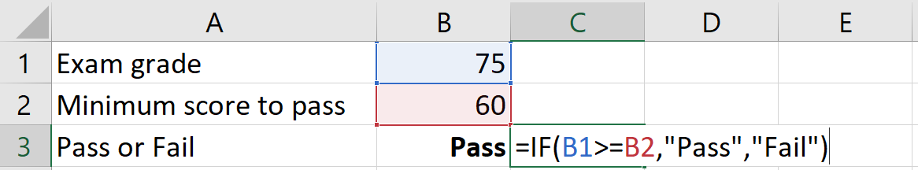
If function
Logical test:
Check if the exam grade is greater or equal than 60.
If logical test is TRUE, then return “Pass”.
If logical test is FALSE, then return “Fail”.

Slide 5
AND / or functions
These functions return a TRUE or FALSE statement.
=AND() → test if two or more logical tests are all true.
=OR() → test if any of two or more logical tests are true.
Can be useful in combination with =IF().

Slide 6
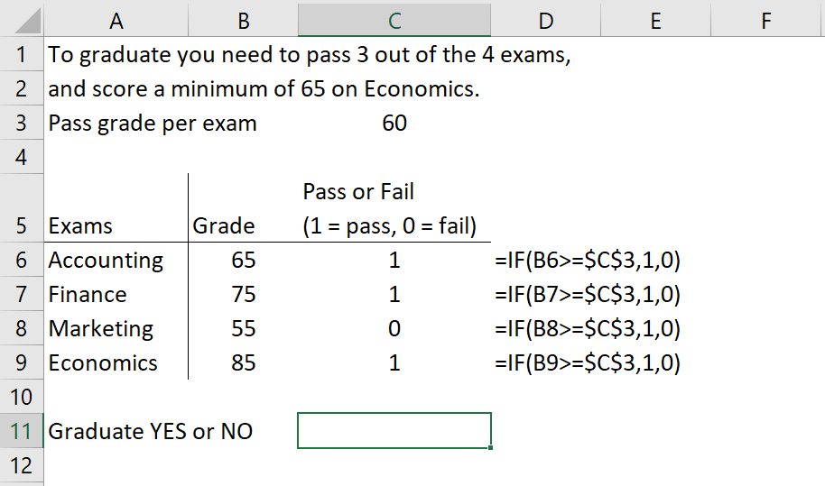
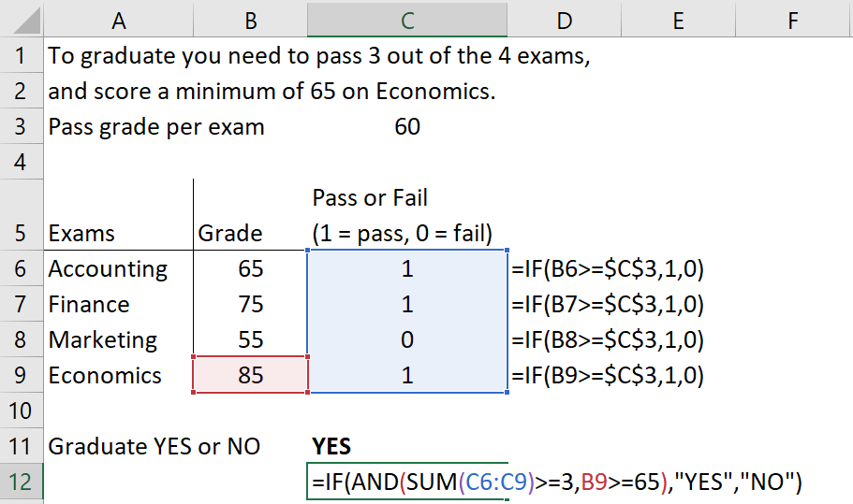
Combining if + and functions
Logical test

Slide 7


If and ifs
The IFS function in Excel is used to check whether one or more conditions are met and returns a value that corresponds to the first TRUE condition.
It can take the place of multiple nested IF statements, making it easier to read with multiple conditions.
Syntax: =IFS([Something is True1, Value if True1, Something is True2, Value if True2, Something is True3, Value if True3, ...])
What is this example ‘saying’? In small groups, take a moment to parse it out.
Image generated by Dall-E

Slide 8

WhEN IFS get complicated
The IFS function allows you to test up to 127 different conditions.
However, it’s recommended not to nest too many conditions with IF or IFS statements as they need to be entered in the correct order and can be difficult to build, test, and update.
There will still be times when you do have to test multiple conditions simultaneously. How can we make this as manageable as possible?
In the next few slides, we will look at ways of handling more complex conditional chains.
Image generated by Dall-E

Slide 9
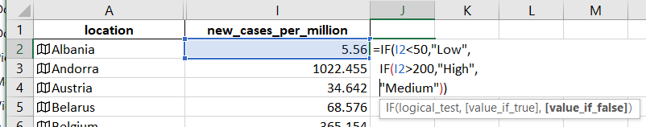
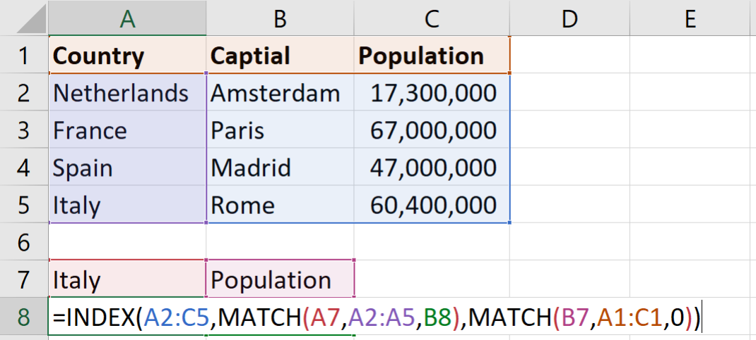

What are Nested FormULAE?
A nested formula is when any formula appears inside another.
The examples you will most commonly encounter are nested IFs ….
… and the ubiquitous VLOOKUP or INDEX/MATCH combination

Slide 10
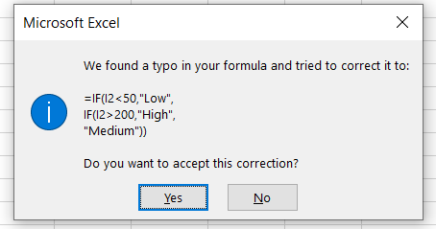

WORKING with NESTED FORMULAE
Keeping track of where you are when writing complex nested formulae can be difficult, and often results in errors like this one:
There are several ways to make this easier. Firstly, break the formula into new lines using ALT + RETURN:
Secondly, follow through the formula stepwise using F9 (on Windows; there is no Mac equivalent)

Slide 11

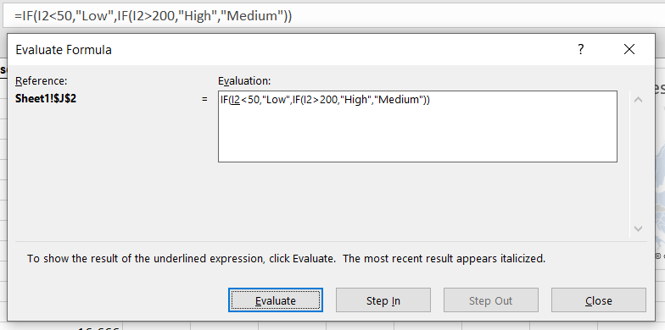

Working with nested formulae: the Evaluate tool
Another useful feature is the evaluate tool. You may find that this is greyed out, in which case check the formula you are auditing is not protected. If this is not the issue, go to Options > Advanced > Display and ensure all objects are displayed.
Press the Evaluate button in the resulting dialog. This will execute each step of the formula in succession. This is useful for testing the validity of complex conditions, among other things.

Slide 12
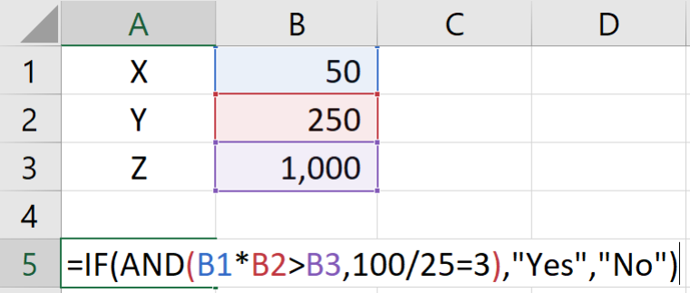
Nested conditional formulae with and, or, xor
Conditions can be dependent on more than one variable. In such cases they can be chained using nested formulae with AND, OR and XOR (the so-called “exclusive or”.
XOR differs from OR as follows:
Assume two statements, X and Y.
XOR is true only if:
X is true and Y is false
X is false and Y is true
OR is also true if X and Y are both true.

Slide 13
Alternatives to nested formulae
Nested formulae, if the nesting is sufficiently deep (for example, three or more embedded IFs) can become cumbersome to write and maintain.
It can help in building up a complex formula to break it up over several cells and do a final check of each cell’s results.
The approach is the same as with the Evaluate tool – stepwise execution – but more visually intuitive.
In extreme cases – that is, with many such ‘decomposed’ formulae – your sheet can have more extra columns than is comfortable (which could even have a significant effect on files size). But as a step in the development process, it can help.
When working with multiple conditions, check if the logic of a nested conditional (with multiple IFs) can be replicated using the multiconditional functions like SUMIFS, COUNTIFS and so on.

Slide 14
IFERROR FUNCTION
The IFERROR function is a useful function to deal with potential errors in your spreadsheets.
Common errors are:
Divide by 0 → #DIV/0!
A lookup value is not found → #N/A
A valid cell reference is no longer available → #REF!
Something wrong with the formula or cell referencing → #VALUE!
=IFERROR(function / lookup / calculation, what value to return in case of an error)

Slide 15
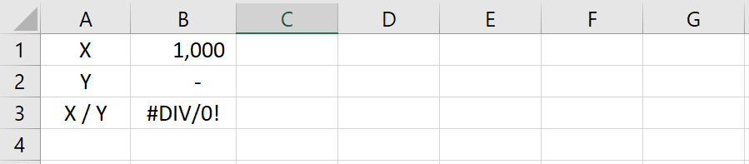
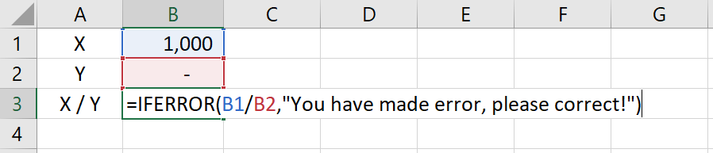
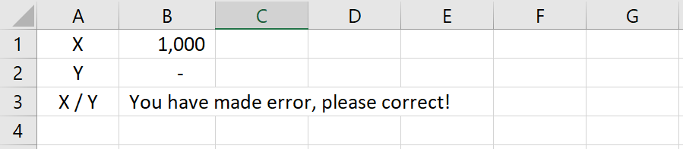
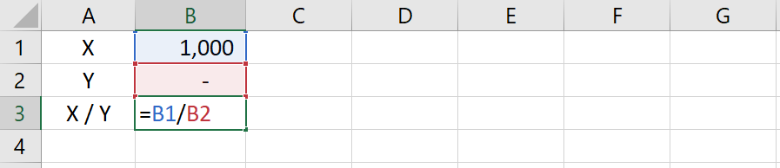
IFERROR FUNCTION
If the output of this calculation triggers an error, do something.
What to return in case of an error.

Slide 16
Other logical functions
=SUMIF()
Only take the sum of values that meet a certain criteria.
=SUMIFS()
Only take the sum of values that meet multiple criteria.
=COUNTIF()
Count the number of values that meet a certain criteria.
=COUNTIFS()
Count the number of values that meet multiple criteria.
Notes:
Worth pointing out here that the syntax for these is somewhat different. Especially when you’re trying to reference cell values. They’ll need to know this for the exercise. Typical syntax is: =COUNTIF(ValuesArray,LogicalTestAsString) For example: =COUNTIF(F12:F514,">=20”) # the number of values in the given array greater or equal to 20
But this won’t work: =COUNTIF(F12:F514,">=G7”) # returns 0 because “G7” is an uncountable value Solution: =COUNTIF(F12:F514,">=“&G7) # attach the cell value to the end of the formula with the & concatenator

Slide 17
exercise
Please open up the Excel Workbook that accompanies this module and try to answer the questions.

